Slide 1

Unit 3: Lesson 1 The power of balance
U ovoj ćeš lekciji razgovarati o dobrobitima rekreativnog vježbanja koristeći ciljani vokabular.

Slide 2
Open your book, page 50
Task 1: Have you ever been to the gym?
Task 2: Match the words and the pictures using the Internet.
Task 3: Can you demonstrate any of these exercises?
Task 4: Which part of the body do these exercises affect the most?
Task 5: Answer the questions.
7
3
1
6
2
4
5

Slide 3
Task 6: Listen to the text and put the topics in the correct order.
https://www.e-sfera.hr/dodatni-digitalni-sadrzaji/bab6586f-6c00-4068-8de2-1fd965abad4c/
7
4
5
6
2
3

Slide 4
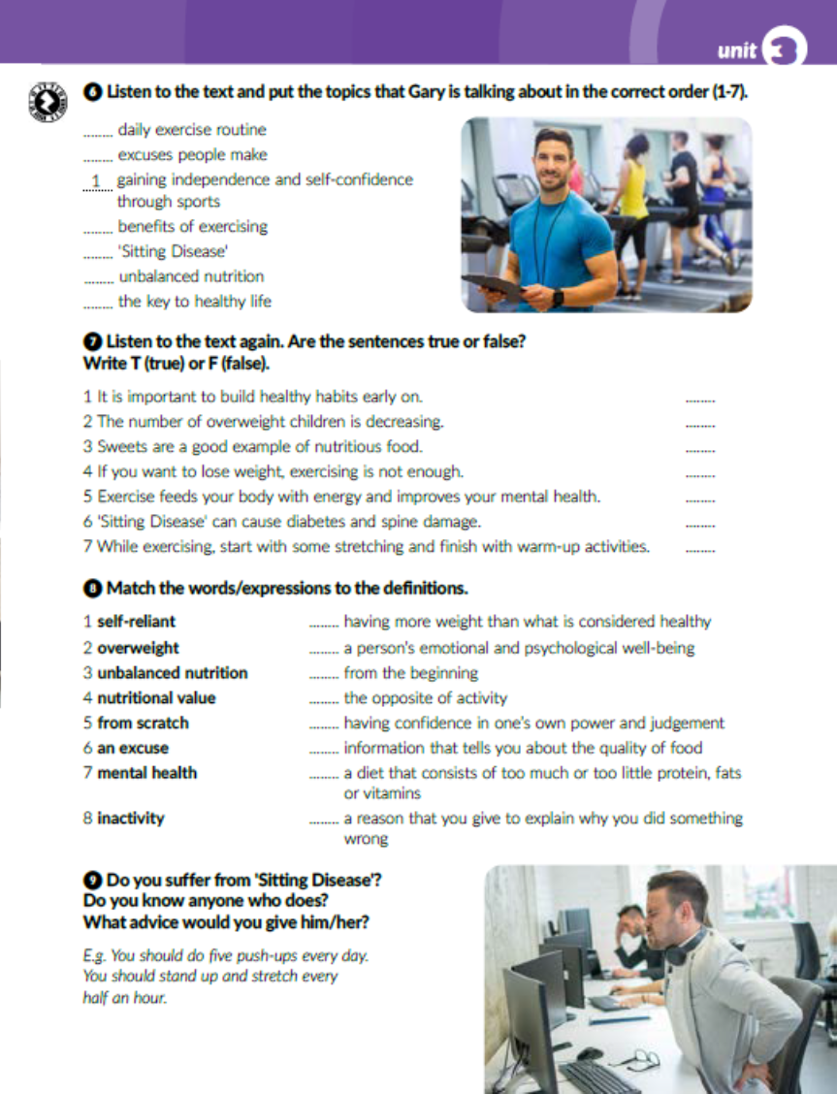
Task 7: Listen to the text again and write T (true) or F (false).
https://www.e-sfera.hr/dodatni-digitalni-sadrzaji/bab6586f-6c00-4068-8de2-1fd965abad4c/
T
F
F
T
T
T
F

Slide 5

Task 8: Match the words/expressions to the definitions.
2
7
5
8
1
4
3
6

Slide 6

Task 9: Do you know anyone who suffers from Sitting Disease? What advice would you give him/her?

Slide 7
Open your workbook, page 48
Task 1: Write the correct number on the line.
20
2
19
6
10
3
1
4
11
9
15
17
16
7
13
5
18
12
8
14

Slide 8
Task 2: Match the type of exercise to the instruction.
2
5
6
4
3
7

Slide 9
Task 3: Find pairs and translate them. Pronađi parove i prevedi ih.
mental health mentalno zdravlje
healthy habits zdrave navike
positive attitude pozitivan stav
unbalanced nutrition neuravnotežena prehrana
physical activity fizička aktivnost
empty calories prazne kalorije
nutritional value nutritivna vrijednost
lose weight smršaviti

Slide 10
Task 4: Complete the sentences with the words/expressions from the box..
mental health
inactivity
self-reliant
from scratch
overweight
nutritional value
stretch
excuse

Slide 11
Task 5: Give advice using should or shouldn’t.
should
shouldn’t
should
shouldn’t
should
should
shouldn’t
should

Slide 12

Otvori sljedeću poveznicu, te odaberi PLAY AND LEARN!
https://www.e-sfera.hr/dodatni-digitalni-sadrzaji/bab6586f-6c00-4068-8de2-1fd965abad4c/

